Slide 1
Welcome
My child, my life, my family
25th June, 2020
Interdisciplinary Research Network: Adverse Childhood Experiences and ACE Network North East

Slide 2
Agenda and Housekeeping
My child, my life, my family agenda
Please
Take as many breaks as you need
Use the chat box to make comments and ask questions
Mute your microphones when you are not speaking
Enjoy the day
Tweet @ACEnetworkNE @sunderlanduni @blogsenco @ruthcoaching @CEL_and_T @Mr_Al_Coates @YvonneNewbold @ElaineAmy_

Slide 3
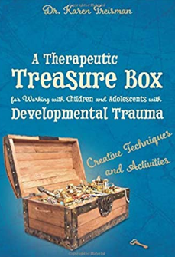
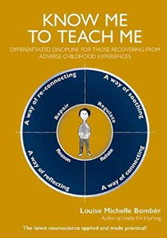
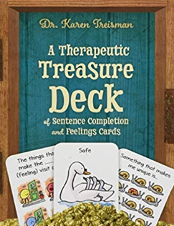
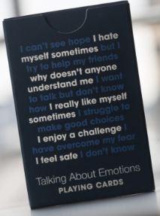
The loan packs
We are hoping for 20-25, they will
be across the region…
https://www.sunderland.ac.uk/events/event/behaviour-is-
language--virtual-international-conference-1014

Slide 4
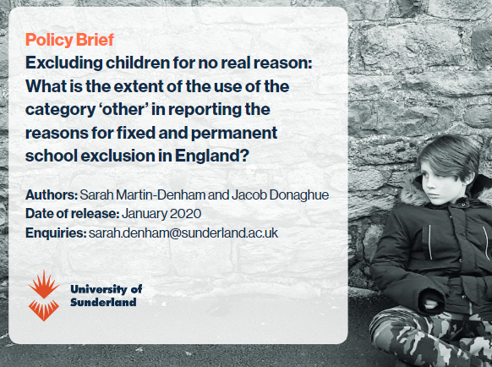
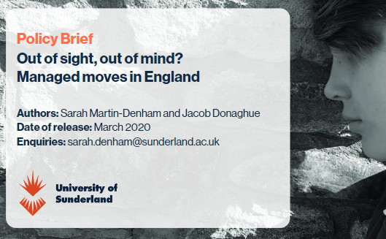
Sarah:@blogsenco
Senior Lecturer and Researcher
Programme Leader and Tutor NASENCO
Author of SENCO Handbook and Teaching Children with SEND​
Convenor Interdisciplinary Research Network: Adverse Childhood Experiences North East​
Chair: Independent SENCO Network​
Senior Fellow Higher Education Academy​
Vice-Chancellor Teaching Fellow

Slide 5
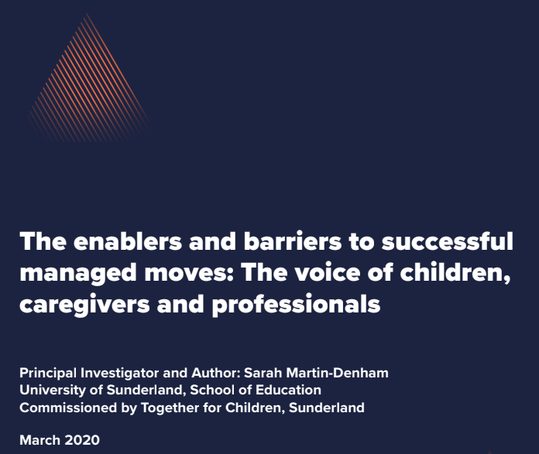
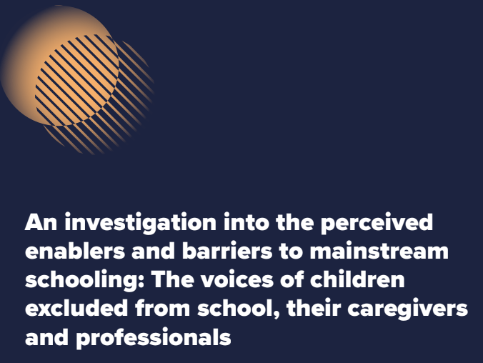
Sarah Martin-Denham (IRN Convenor UoS)
9:15-10:15 am
‘Enablers and Barriers to Mainstream Schooling: Learning from research on school exclusions with caregivers, children and professionals’
(sure.sunderland.ac.uk – Search by Author Martin-Denham: publication 8)

Slide 6
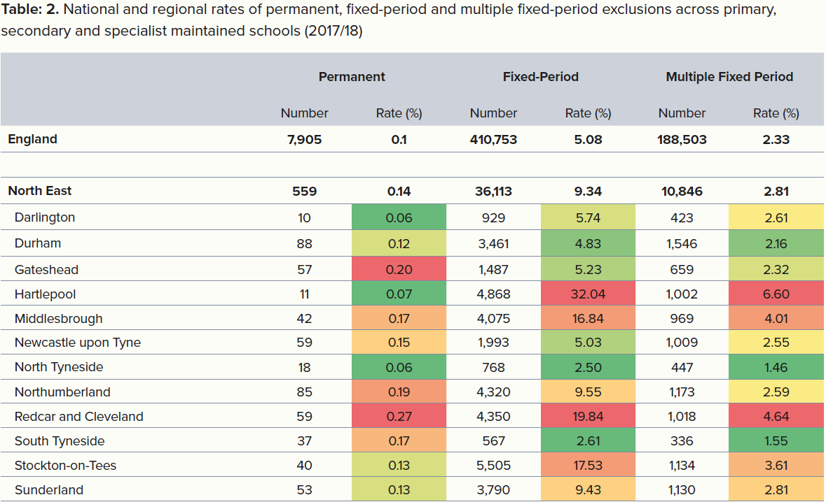
Martin-Denham and Donaghue (2020)

Slide 7
Exclusion Research in Sunderland
In total there were 174 participants interviewed. In addition, there were three advisory groups, 12 children, five professionals from health/support services and five education professionals.
This is the most substantial piece of primary research carried out to date on the enablers and barriers to mainstream schooling for those at risk of school exclusion in England.

Slide 8
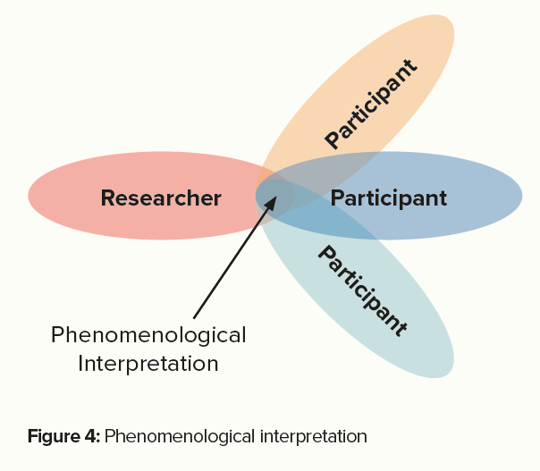
Methodology
As the aim of the research was to provide a detailed examination of personal lived experiences of participants, the qualitative approach chosen was interpretative phenomenological analysis (IPA) (Smith and Osborn, 2015).

Slide 9
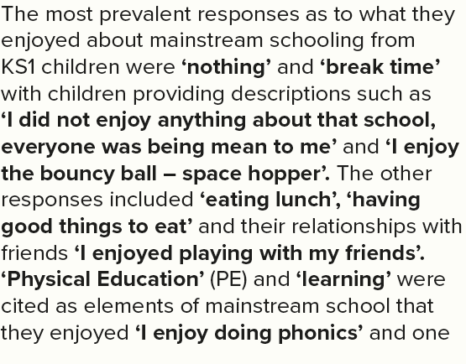
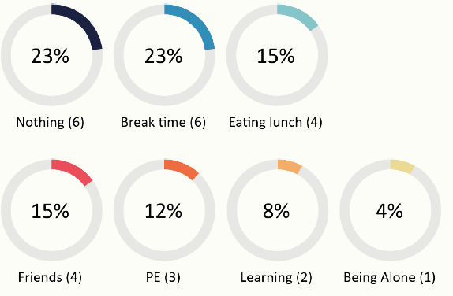
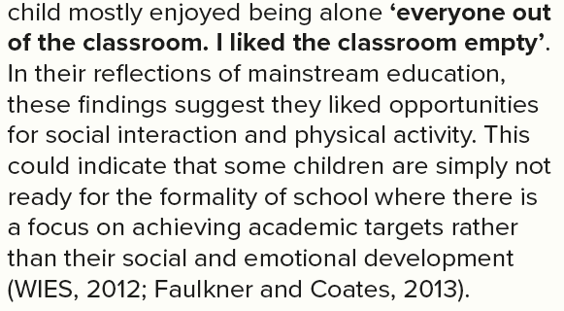
What children in Key Stage 1 enjoy (enablers)
(20 children)
Only 3 out of 35 children in KS2-KS4 could identify a positive aspect of mainstream schooling

Slide 10
What children find difficult
KS1
‘I find it hard when I am doing PE, sometimes punch people because everyone is shouting and chanting it makes me angry (PE)’
‘Noise made me feel pressure, I was upset and angry’
‘Sometimes I do scream that’s how I stop hurting people’
KS2/3
‘There were too many people and I needed so much help, I wasn’t getting any at all, I didn’t cope well’
‘The fire alarms there are so high pitched. That’s why I’m glad I’ve left… It’s a lot, a lot of noises’
‘It is hard for the teachers to get round’
‘It stresses me out. I feel I start to go crazy. When I’m angry that I feel like I’m going crazy’
KS4
‘The fact is when I asked for help they wouldn’t give it to me, they would just say I will come back to you’
‘Thirty children and only one member of staff to support them’
‘They can’t get round a class of thirty, just helping one child all the time’

Slide 11
27/36 children in KS2-4 had been in isolation booths (one from KS2)
KS4 children’s views on impact of isolation booths on learning
‘They just told you to sit down and get on with your work, no teaching’
‘Not taught just worksheets, just had to figure that shit out for myself,
‘I didn’t do anything. So that is why I came to this school knowing nothing (alternative provision), I was so behind
on everything after two and a half years in isolation’
‘I couldn’t even read or write properly, because they used to kick me out of lessons’.
Discussion:
Ability to reflect on behaviours (DCSF, 2008; DfE, 2015)
Children’s ability to self teach (DfE, 2016) time in isolation should be used as constructively as possible

Slide 12
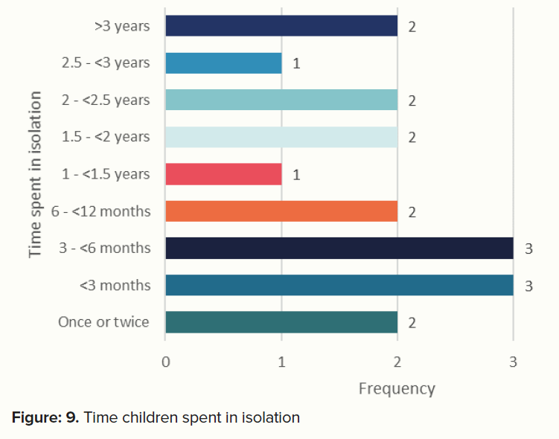
KS4 Length of time in isolation booths

Slide 13
KS4 children’s views on impact of isolation booths on mental health
‘It was depressing I felt alone’
‘I ended up quite lonely’
‘I used to pull my hair out, scratch my face. I couldn’t cope with it at all. The teachers used to sit there and
watch me cry
‘We used to call it ‘the bridge’ because it made you want to just jump off a bridge’
‘I wasn’t allowed out, no fresh air or anything’ and ‘someone kicks off they get locked in’
Discussion
These comments could signify the detrimental impact of isolation booths on the mental health of children as
outlined by CAPBS (2015) that seclusion can be a traumatic experience for children and have adverse consequences
on their emotional development.
It also implies that the wellbeing of children is severely affected, despite a duty on schools to ensure the child’s
welfare (DfE, 2016).

Slide 14
KS4 children’s views on impact of isolation booths on physical health
‘I didn’t like it, it made me feel sick, they just told me to do my work’
‘It made me feel dizzy’
‘You weren’t allowed to cough or breathe loud’
‘You weren’t allowed to turn around or make any noises’.
Discussion
DfE (2016) advice for schools states that schools must ensure the health and welfare of children; these descriptions
suggest this is not the case. The impact on physical health due to social isolation is documented in the literature with
headaches and stomach aches reported by Lohre (2012).

Slide 15
KS4 children’s views on why they were sent to isolation
‘Shouting, hitting pens off their heads. Hitting them with rulers’
‘It was more cheekiness and then carrying on it got to the point where I was told you are not coming into
my lesson’
‘I was really naughty in Year 9, but then in Year 10, I started sorting myself out a bit. But by then the teachers
just didn’t like me at all’
‘I had just arrived from a managed move’
‘Wearing makeup, the wrong skirt, false tan, not wearing the correct shoes or being late for a lesson’
‘I used to purposefully get myself put into what was their isolation, to avoid everyone. They used to wait
outside of the classrooms for me. I used to beg my teachers to let me leave early’
‘I would wear the wrong skirt knowing that I would get put there. I would just do anything’

Slide 16
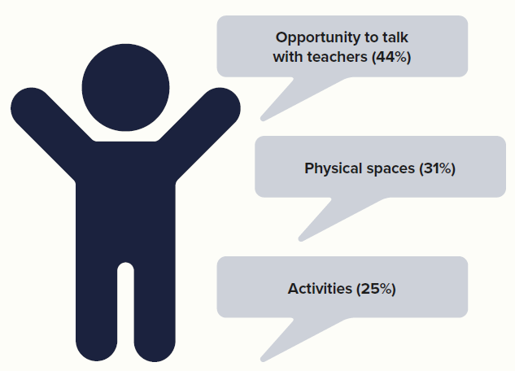
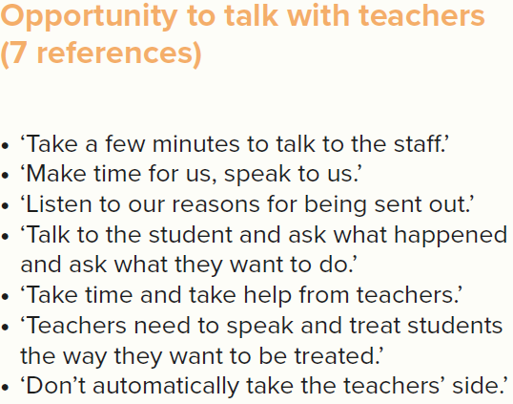
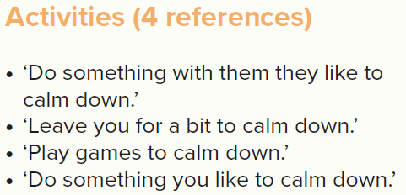
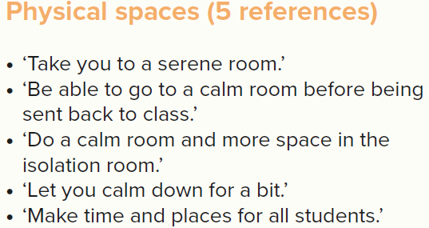
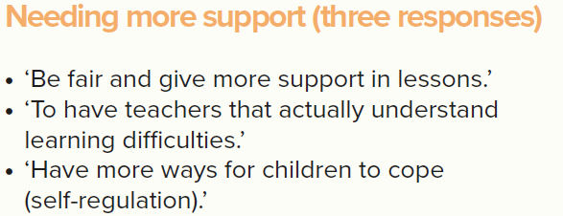
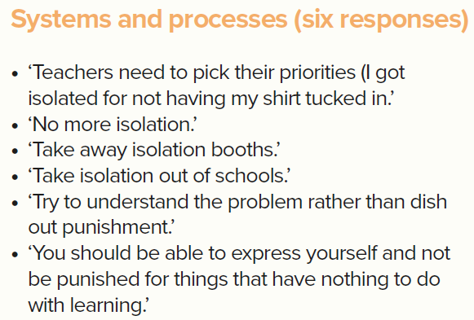
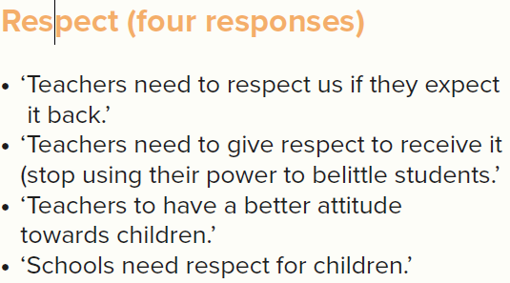

Slide 17
Views of health professionals advisory panel
‘The impact of sitting in silence for a day, week, month or year, you just cannot imagine’
‘By stripping children of their dignity you are perpetrating a corrosive culture, it is dehumanising’
‘What is the impact of isolation on children with regulation needs, isolation is not a reasonable adjustment’
‘Why are the children contained on school premises if they have not been taught?’

Slide 18
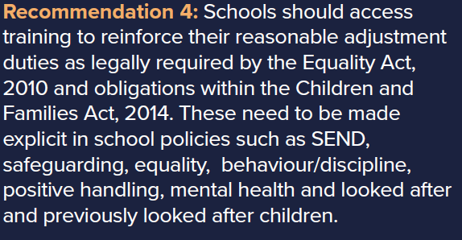
From the advisory group of children and young people
Some of my recommendations

Slide 19
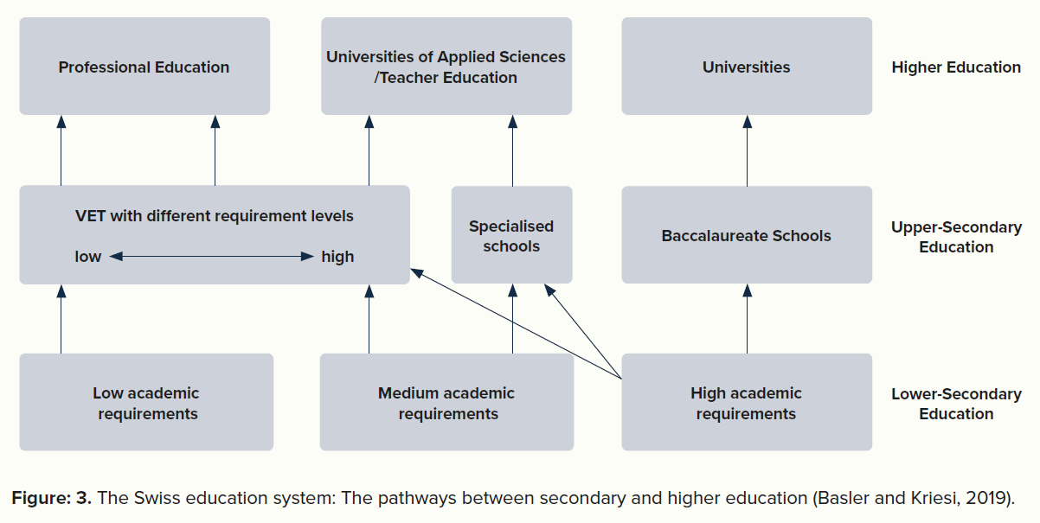

Slide 20
References
Martin-Denham, S. (2020) An investigation into the perceived enablers and barriers to mainstream schooling: The voices of children excluded from school, their caregivers and professionals. Sunderland: University of Sunderland. https://sure.sunderland.ac.uk/id/eprint/11941/
Martin-Denham, S. and Donaghue, J. (2020) A review of fixed-period and permanent exclusions in children with SEN designation in the City of Sunderland. London: University of Sunderland. http://sure.sunderland.ac.uk/id/eprint/11940

Slide 21
Break time
Next Yvonne Newbold
10:30-11:20: Supporting children with SEND and complex behaviours

Slide 22
Sarah Martin-Denham: Managed moves that create a sense of belonging (3:15-4pm)
The publication

Slide 23
KS2-4 children’s views on Why the managed move failed
‘You don’t get very many chances. I was actually quite good in that school… I got a point for laughing,
so that is why I was kicked out’
‘I was meant to have 6 behaviour points, I had 10’
‘Going from being naughty, to a behaviour school, back to a normal school in twelve weeks, how do they
expect me to only get six behaviour points’
‘another child told me to fuck off, saying he was going to do me, the teacher sent him out, then she started
screaming at me so I flipped the table, I said sorry and picked it up straight away’
‘I had a death, as you can understand I didn’t bother with school. I felt like I coped but I went into school, just
cried my eyes out, I just blew up at a member of staff, he was shouting ‘go to your classroom’ they didn’t understand
what was going on in my head’

Slide 24
The findings support the idea that children have a basic psychological need for a sense of belonging in a social group and this increases as the child progresses with age (Maslow, 1943; 1954; 1970).
Some of the reasons for failed managed moves appear to be due to seeking this sense of belonging, to forming and maintaining strong interpersonal relationships and seeking approval from peers which often appear as negative behaviours as discussed by Baumeister and Leary (1995).
An example would be ‘we got caught smoking’ and ‘I got in with the wrong crowd’. The move failed for the behaviour of smoking, but the child may have been smoking with others to be accepted as part of a new social group and to feel connected with others already established in school (Craig, 2015).
‘when I arrived I met the isolation staff, they said this is where you will be sitting, that was basically it, everyday... I was put straight into isolation, I just had to sit there and do nothing, not talk and not move’.

Slide 25
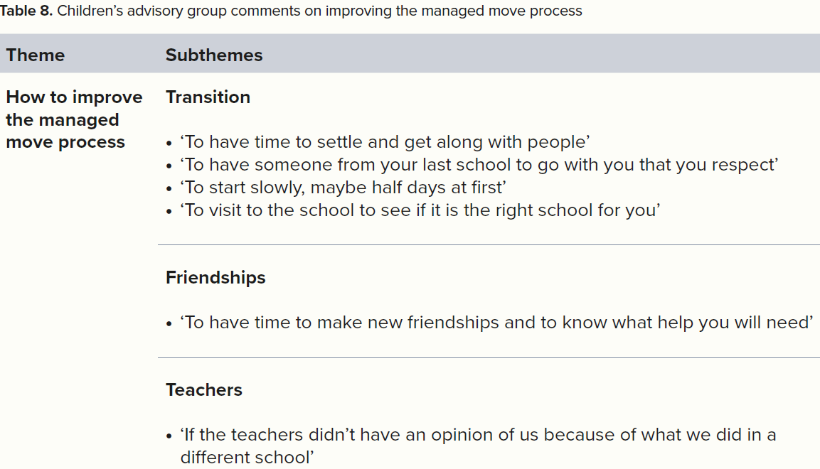

Slide 26
KS4 Caregivers, why the MM failed…
Why it failed
‘My eldest child went on a managed move but the root of the problem was not recognised or supported. How is anything going to change?
‘I just think it stems from the primary school setting, where his confidence was shattered. He has very low self-esteem. He’s got no confidence in himself. If you ask him what he can do, he will say nothing. If you ask him to write, he’ll say he can’t, and he says he can’t read’
The positives
‘We did get more support from the second school’
‘In the end, the managed move school realised what I had said all along that he was Dyslexic. They did a test’.

Slide 27
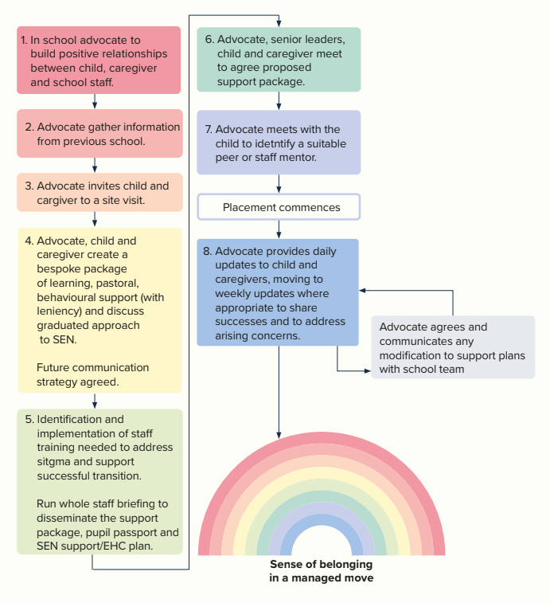
The Managed Move Model
Reference
Martin-Denham, S. (2020) ‘The enablers and barriers to successful managed moves: The voice of children, caregivers and professionals.’ Sunderland: University of Sunderland.

Slide 28
References
Martin-Denham, S. (2020) ‘The enablers and barriers to successful managed moves: The voice of children, caregivers and professionals.’ Sunderland: University of Sunderland. https://sure.sunderland.ac.uk/id/eprint/11942/

